Slide 1

“Our future is safer without corruption”
compliance.uz

Slide 2

PROBLEM
Artificial intelligence (AI) has developed rapidly in the last few years. It has demonstrated impact in a number of ‘classic’ anti-corruption areas – procurement integrity, compliance, fraud detection and anti-money laundering.
HOW WE CAN USE
ARTIFICIAL INTELLIGENCE
IN ANTI-CORRUPTION SYSTEM OF UZBEKISTAN

Slide 3





OPPORTUNITIES
HR
CHECKING POINT
DATABASE
ID DATABASE
BANK ACCOUNT
DATABASE
HOW WE CAN DO PREDICT WHO CAN DO CORRUPTION TODAY?

Slide 4




OUR SOLUTION
THIS PROGRAMM CAN ANALYSIS DATABASE ABOUT EMPLOYEES AND PREDICTS THEIR CORRUPTION ABILITY
www.compliance.uz
SEPARATE THE LEVEL OF EMPLOYEES' PROPENSITY TO CORRUPTION
WORKING ONLY WITH “RED GROUP” MEMBERS
SAVE GOVERNMENT BUDGET
MAKE OUR FUTURE WITHOUT CORRUPTION

Slide 5



COOPERATION WITH GOVERNMENT
RESULT
GOVERNMENT
AUTHORITIES
OFFICER
OF COMPLIANCE SERVICE
SALARY PER MONTH
EVERBODY HAS OWN DESICION
126
1840
18,4
BILLION
COMPLIANCE.UZ
+
RESULT
GOVERNMENT
AUTHORITIES
OFFICER
OF COMPLIANCE SERVICE
SALARY PER MONTH
WE CAN HELP PREDICT CORRUPTION FACTS EARLIER
126
500
5
BILLION

Slide 6
ROADMAP
MORE THAN 100 GOVERNMENT AUTHORITIES HAVE COMPLIANCE DEPARTMENTS
WE WILL DO UPGRADE IN COMPLIANCE.UZ AND WE WILL ADD CHANCE TO FIND INFORMATION CORRUPTIONER PRIVATE SECTOR MEMBERS
DON’T HAVE ANY DIGITAL ANALYSIS SYSTEM
2025
2028
2026
2030
ALL COMPLIANCE DEPARTMENTS CAN FIND CORRUPTIONERS VIA OUR COMPLIANCE.UZ
COMPLIANCE.UZ PLATFORM WILL HELP MAKE UZBEKISTAN COUNTRY WITHOUT CORRUPTION

Slide 7
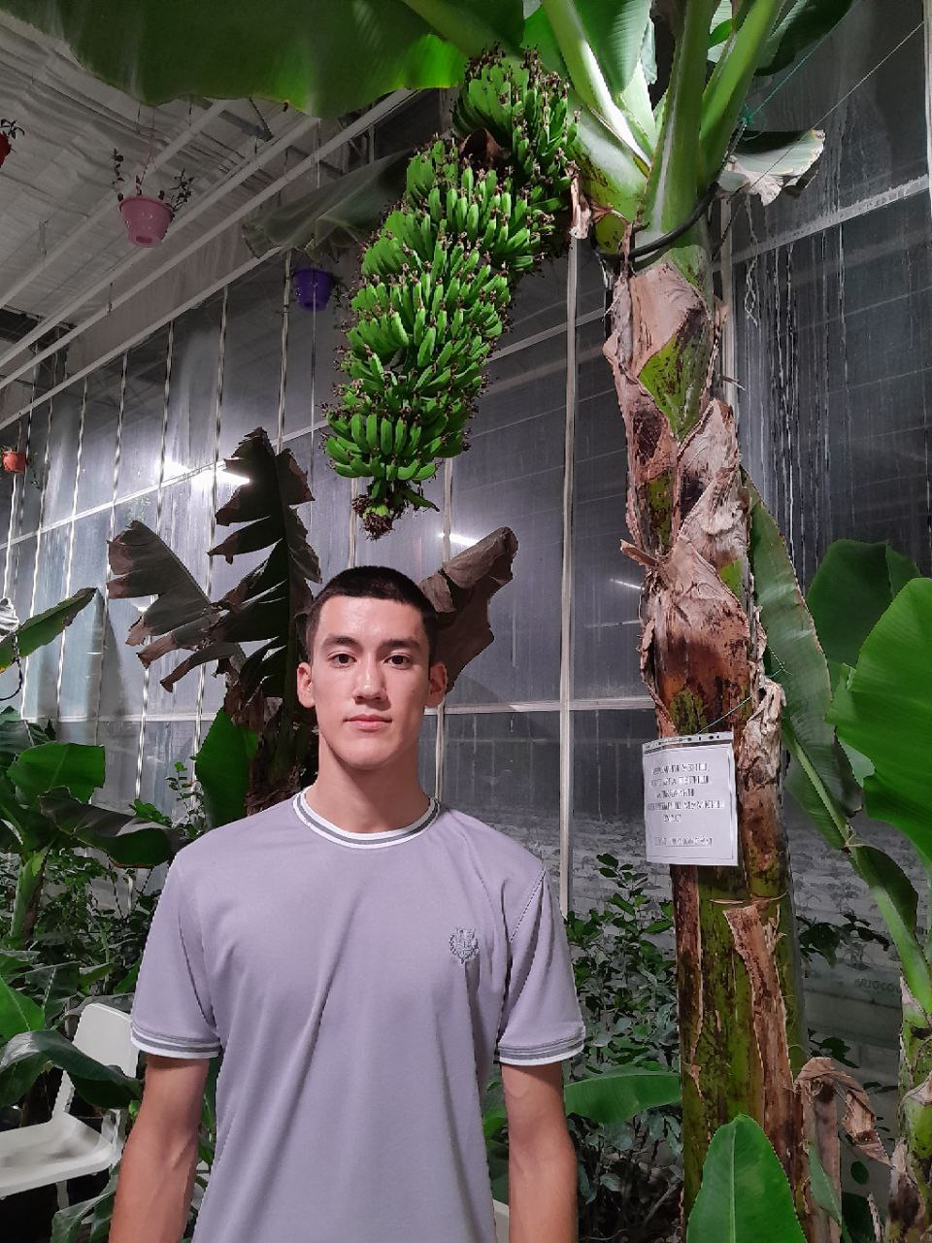
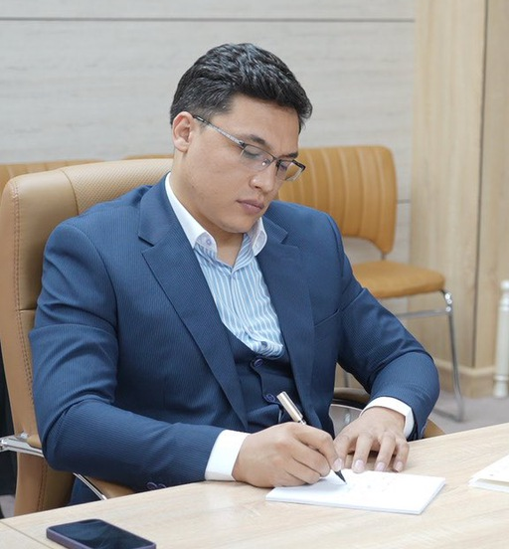


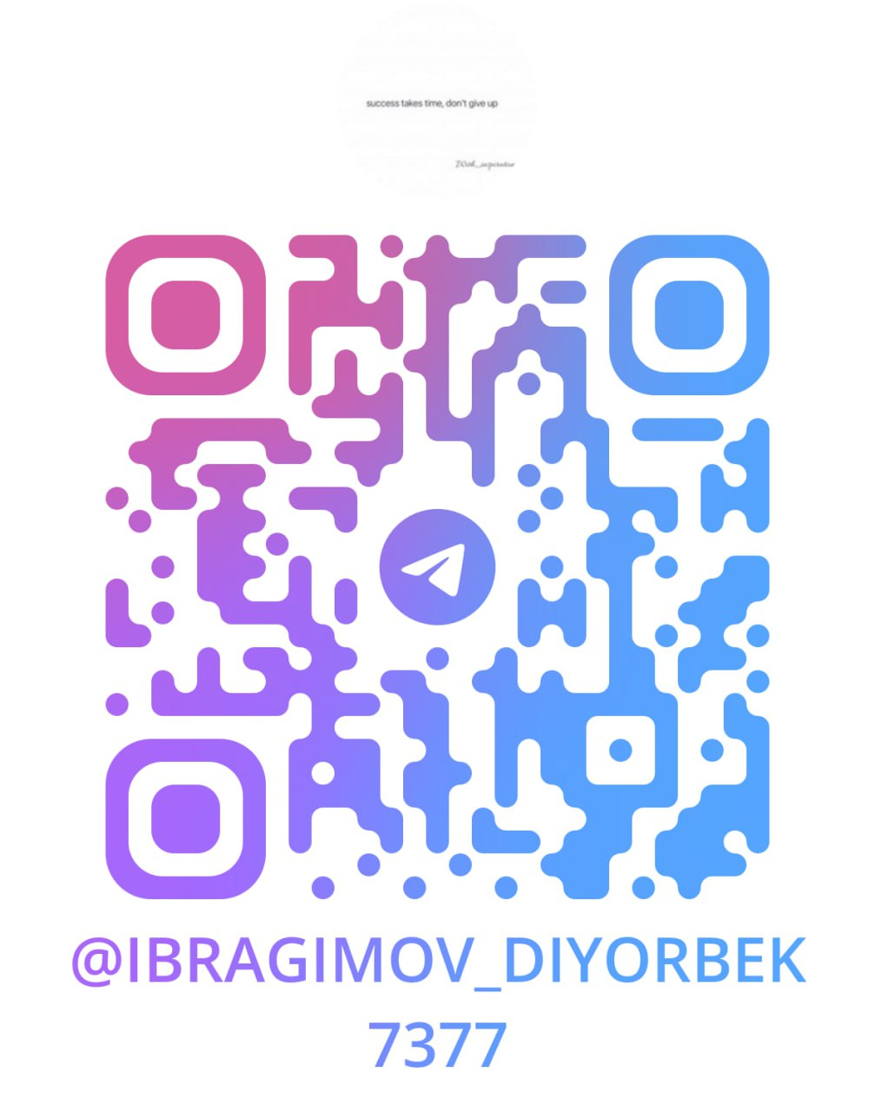

OUR TEAM
PROJECT MANAGER
RAKHIMOV SARVARBEK ABDUMUTALLIBJONOVICH
BACK END DEVELOPER
SHUKHRATOV SHOKHIJAKHONBEK SHERMAT OGLI
FRONT END DEVELOPER
IBRAGIMOV DIYORBEK SHUKHRAT OGLI

Slide 8


FEBA

